Slide 1
LetsGo
Travel Together

Slide 2
TABLE OF CONTENTS
01
02
03
ABOUT THE PROJECT
REQUIREMENTS
PROJECT GOALS
04
05
PROJECT STAGES
OUR TEAM

Slide 3

Some
Numbers…
In the U.S. 54 million people have taken a vacation by themselves in 2021, and more than 27 million said they want to travel with company the next time

Slide 4
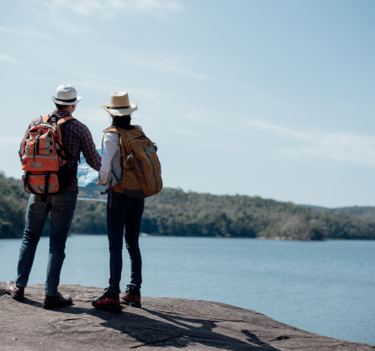
ABOUT THE PROJECT
Travel In Groups
Specific platform for travelers from all over the world
Create new connections between solo travelers

Slide 5
—SOMEONE FAMOUS
“Life is an adventure best traveled together.”

Slide 6

THIS IS NOW
Social networks are not compatible
Mutual friends

Slide 7

IN THE FUTURE
LetsGo
Personal Customized Platform

Slide 8
MAJOR REQUIREMENTS
User Matching
Profiling
Identification
Rating
Description
Location
Age
Duration
Budget

Slide 9

$8,500,000
This is the total budget

Slide 10
$-32,796
This is the actual budget :)

Slide 11
PROJECT GOALS
Community
Money
Time
Build a strong community of travelers from all over the world
Free to use
Faster than ever to find the perfect partner

Slide 12
PROJECT STAGES
 | MVP | V1.0
Client | Initial screens | User Friendly (UX/UI), Social Network Identification
Server | Architecture, DB, Map API | Social Network Identification, Profiling, Chat

Slide 13

MONTHLY TIMELINE
JANUARY
MARCH
JUNE
JULY
Beginning Of The Project
Alpha
Initial Working Product
Bug Fixes

Slide 14

OUR TEAM
Arad Peer
Omer Pessach
Nir Timor

Slide 15
THANK YOU

